Slide 1

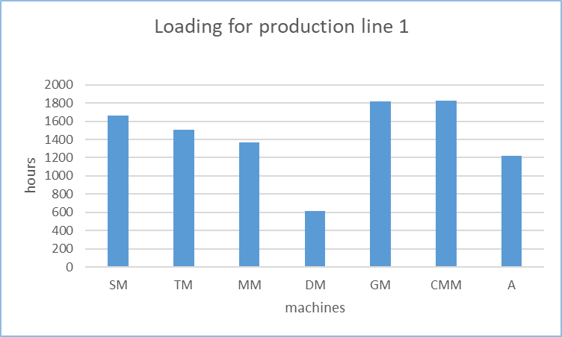
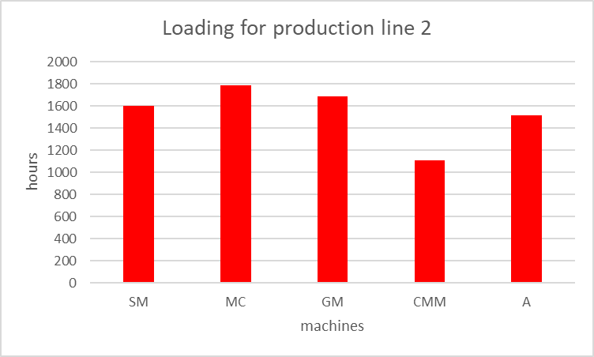
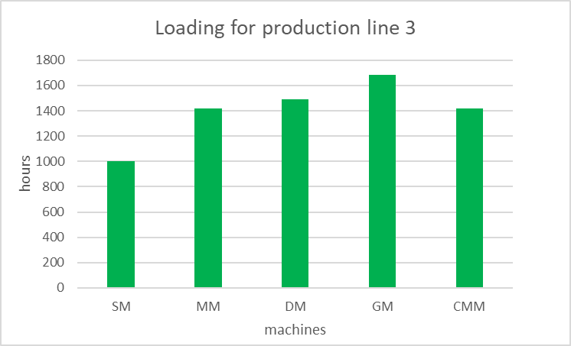
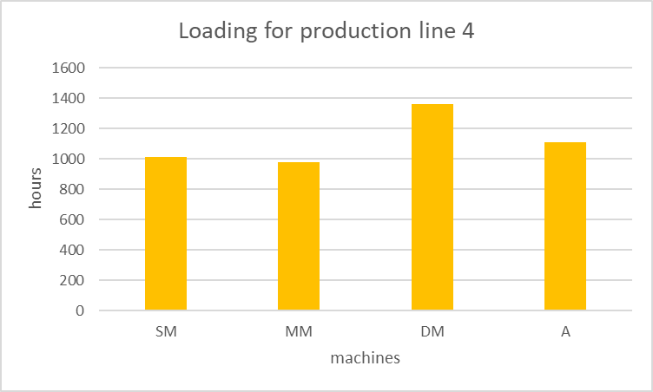
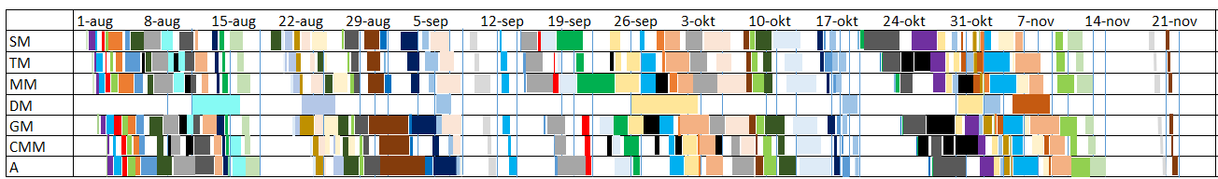
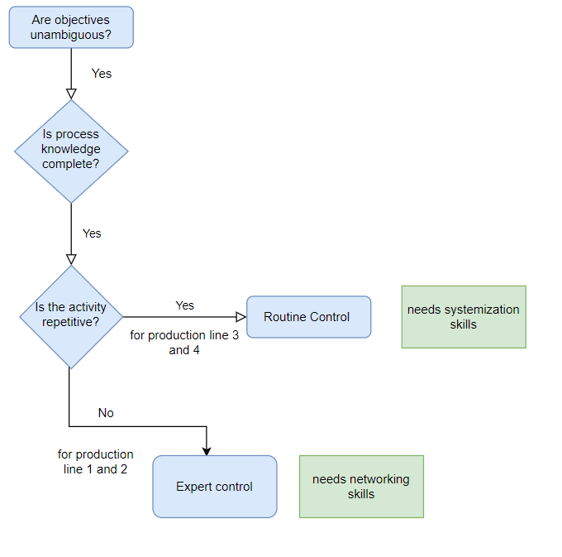
ME Module 11 : Production Systems Engineering
Group 2 | Faculty of Engineering Technology (ET)
University of Twente, Netherlands | 2022
Production Planning & Control
Ruchira Rupakula (2263319)
Floris Kaper (2359200)
Mats Olde Dubbelink (2384752)
Loading
Sequencing
A load means the quantity of work, and allocating the quantity of work to the processes necessary to manufacture each item is called loading.
The type of loading that can be applied here is finite loading as in this approach the work is allocated to specific workstations for a set limit of time and in our case it is 4 months.
This limit is the estimate of capacity for the work center (based on the times available for loading).
Total Time available Specification
No.of available working hours = 15.5 (no.of hours per day) x 7(days) x 18(weeks) = 1953 hours
Below shows the loading of 4 different production lines . The first production line shows the combined production for the lines 1,5 and 6 from the product portfolio. The second picture shows for line 2 and 4 followed by the 3rd loading image that describes the 3 lines alone. The 4th production line shows the production process for new parts.
 | SM | TM | MM | MC | DM | GM | CMM | A
Line 1 | 2 | 3 | 3 | 0 | 1 | 3 | 1 | 2
Line 2 | 1 | 0 | 0 | 3 | 0 | 2 | 1 | 2
Line 3 | 2 | 0 | 3 | 0 | 2 | 0 | 1 | 0
Line 4 | 1 | 0 | 2 | 0 | 2 | 0 | 0 | 1
Total | 6 | 3 | 8 | 3 | 5 | 5 | 3 | 5
Sequencing on due date
 | Total Lateness (Production days) | Average Lateness (Production days) | Process time (Production days) | Average time in process (Production days)
Line 1 | 239 | 1.96 | 6391.5 | 56.4
Line 2 | 7 | 0.10 | 3027.0 | 43.9
Line 3 | 0 | 0 | 574.1 | 31.9
Line 4 | 0 | 0 | 2228.6 | 43.7
Total | 246 | 0.98 | 12 221.2 | 48.5
Sequencing on order size
 | Total Lateness (Production days) | Average Lateness (Production days) | Process time (Production days) | Average time in process (Production days)
Line 1 | 1214 | 9.95 | 5269.2 | 42.8
Line 2 | 362 | 5.25 | 2161.2 | 31.3
Line 3 | 0 | 0 | 400.4 | 22.2
Line 4 | 102 | 1.48 | 1777.3 | 34.8
Total | 1678 | 6.66 | 9608.1 | 38.1
Line 1 has high lateness and this is caused by the large amount of orders with a due date in the beginning of august. The machine which is responsible for this problem is the assembly table. In the end, everything is still finished in the predetermined four month period. This lateness can be reduced by adding another assembly table to the now two assembly tables. This will increase the cost and the time where the assembly tables are not used but significantly decreases the total lateness to 7 days with a average of 0.057 for the due date and 1199 days with a average of 9.83 for the shortest operation time. Sequencing is chosen to be by due date as the lateness of sequencing on order size is unacceptable even though the process time is better.
Scheduling
Production line 1
Production line 4
Production line 1 includes the most parts and is the most complex order pattern, which is the reason why this planning was made. Production line 4 includes all product for the new cranes. A schedule is made for 25 cranes each month which matches the order. This same schedule is repeated four times to manufacture the requested 100 cranes.
Monitor and Control
Conclusion
With the help of the decision tree, an idea of the nature of the operations can be identified. Operational/routine control is relatively straightforward: objectives are known and activities are repetitive, meaning any divergence from it would require a different type of control.
Expert control would be necessary as well as for production lines 1 and 2, not all products follow the same pattern so there is a need for expertise and integrating of that expertise into the organization.
From the loading it can be concluded that not all machines in the production lines will be loaded at all time. This is results from the size of the relatively small production lines which makes that only one machine is often enough for the required production. The loading could be increased by further combining the production lines but this will then cause problems for sequencing and scheduling. A trade off was made even though it increased the complexity of scheduling as the OEE of the machines was much larger. The sequencing is determined by trying to keep the lateness as low as possible while keeping the process time reasonable. Sequencing by due date was chosen and it was concluded that it could be further improved by adding an extra machine.
Planning was done in such a way that no orders were late. This means that orders that were finished earlier than the due date had to be stored. Due to this, warehousing increased. It can be seen that there is relatively much whitespace between the processes. This is probably due to a wrong number of machine. For the number of machines a 5-day workweek was considered, whereas this is 7 days for planning. If the number of machines needed for a 7-day workweek were used, less machines are necessary and therefore the whitespace will be less. However, the whitespace gives room for unexpected orders and unexpected or preventive maintenance, which is a upside of the whitespace.
Monitor and control cannot be a routine always as the operations in different production lines are not always predictable and repetitive. From the picture on the left it can be concluded that a lot of people would be needed for control of production line 1 and 2 as these are the bulkiest production lines which need close expert control.
UNIVERSITY OF TWENTE.

